Slide 1


Generative AI
Full Stack Developer
01

Slide 2
Course B : RAG
Retrieval Augmented Generation
05

Slide 3
02 - Building Retrieval Systems
03

Slide 4






RAG - Retrieval Augmented Generation
1.Retrieval
2. Augmentation
3. Generation
Ask
Question +
Generate
Question
LLM
Explicit source informed answer
look-up
Relevant documents
Specific Knowledge base
04

Slide 5
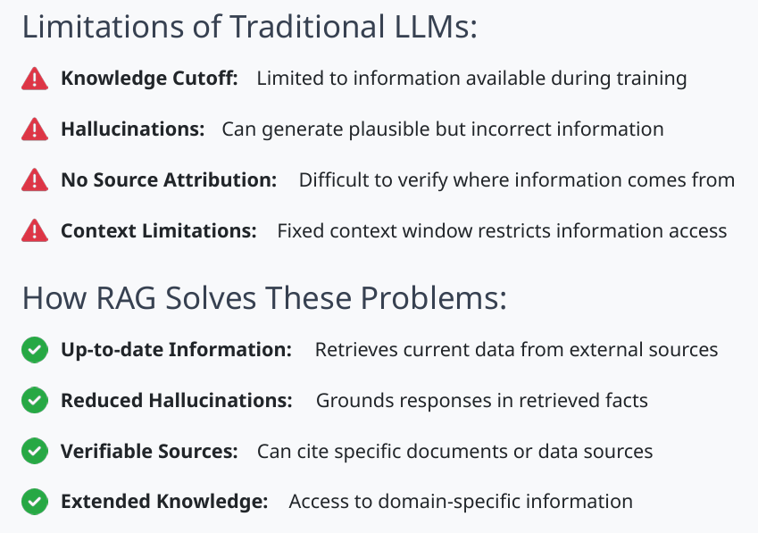
Why RAG (Retrieval Augmented Generation) ?
The Problem with Traditional LLMs
04

Slide 6
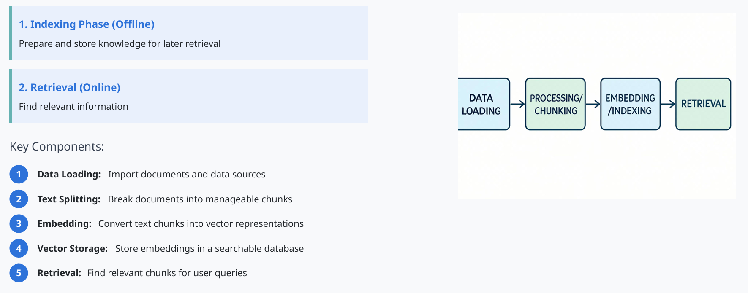
Overview of a Retrieval System
05

Slide 7
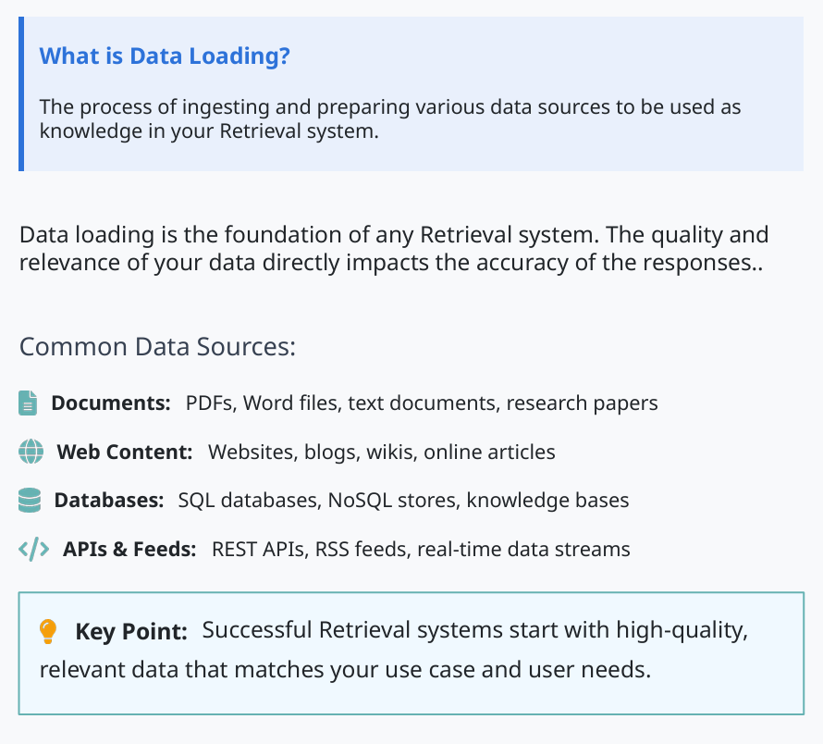
Step 1: Loading Data - Introduction
06

Slide 8
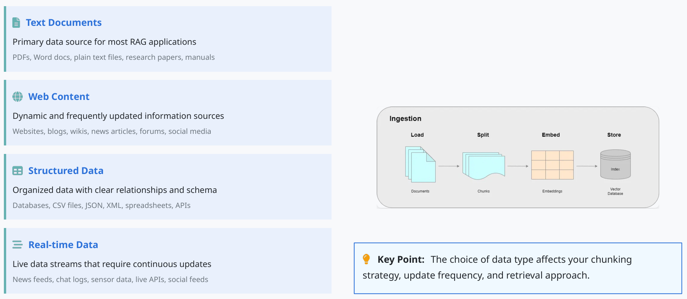
Data Types for Retrieval Systems
07

Slide 9
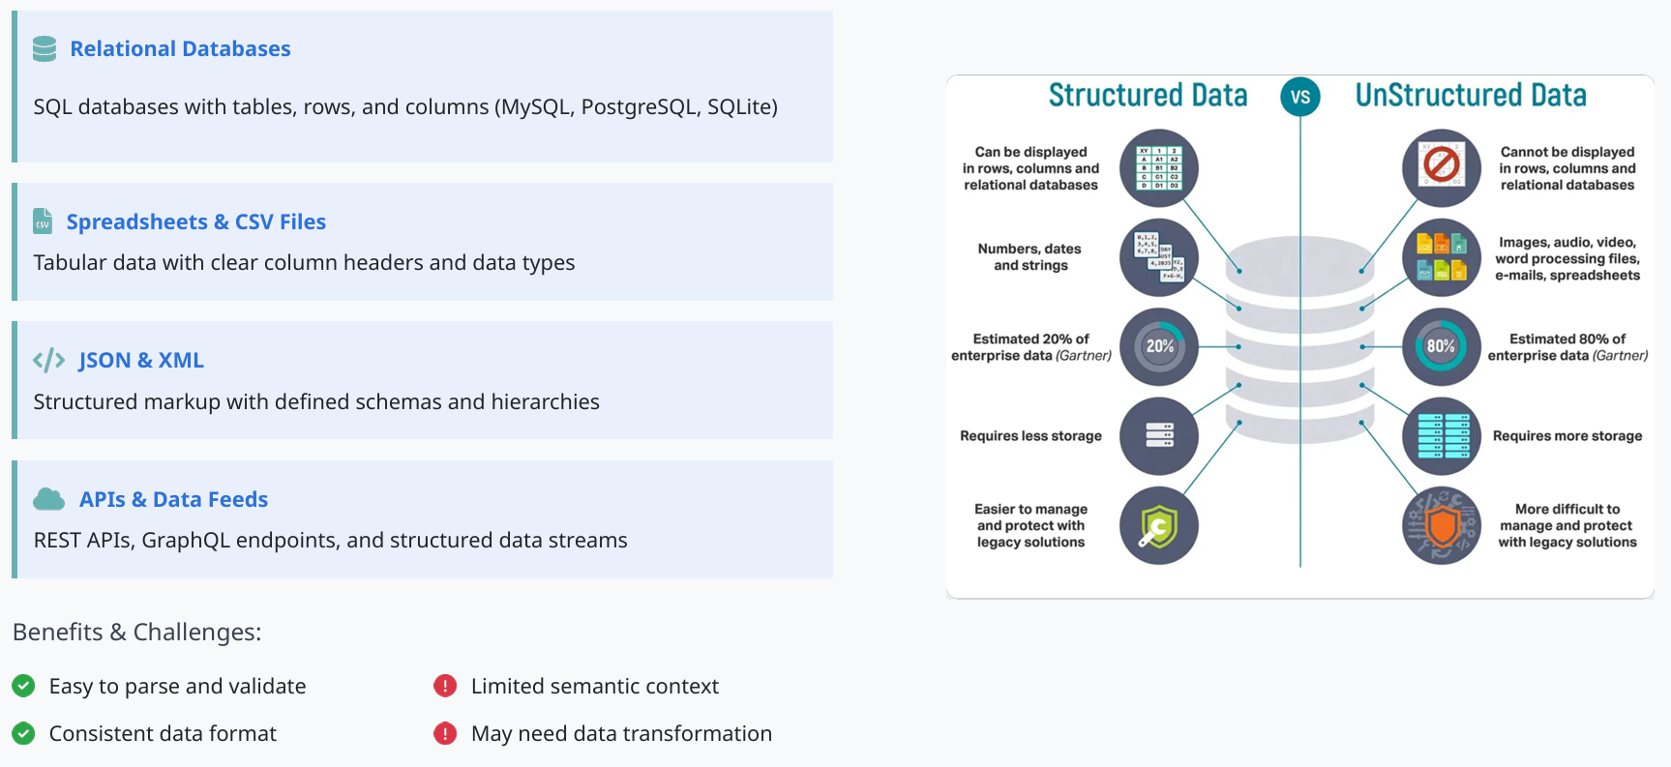
Working with Structured Data
Structured data has a predefined format and organization, making it easier to process and query.
08

Slide 10
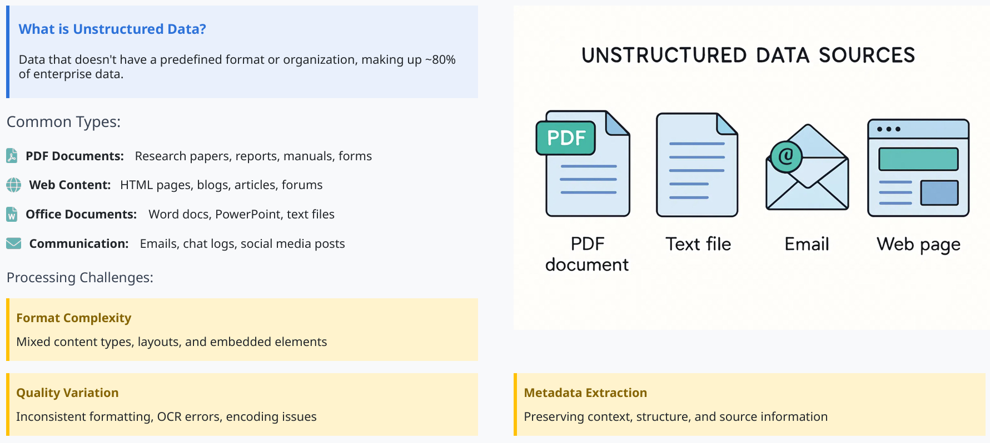
Working with Unstructured Data
09

Slide 11
Practice

Slide 12
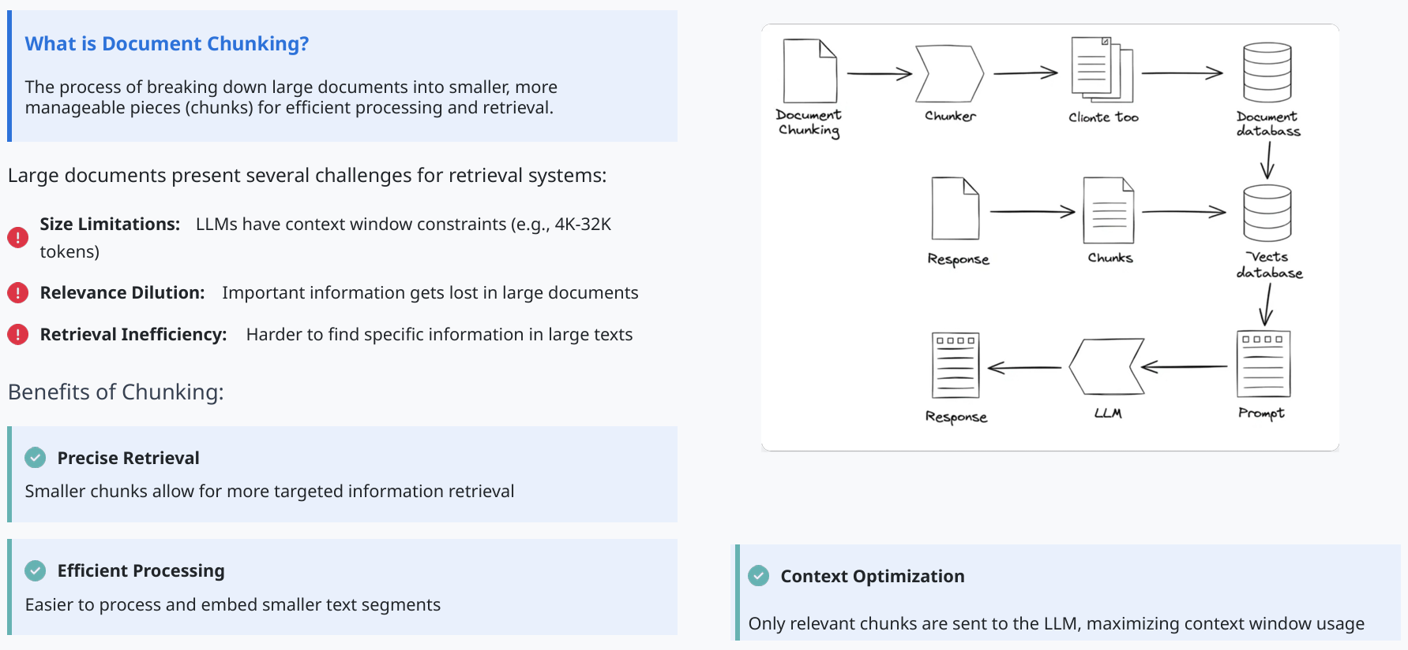
Step 2: Splitting and Chunking - Introduction
11

Slide 13
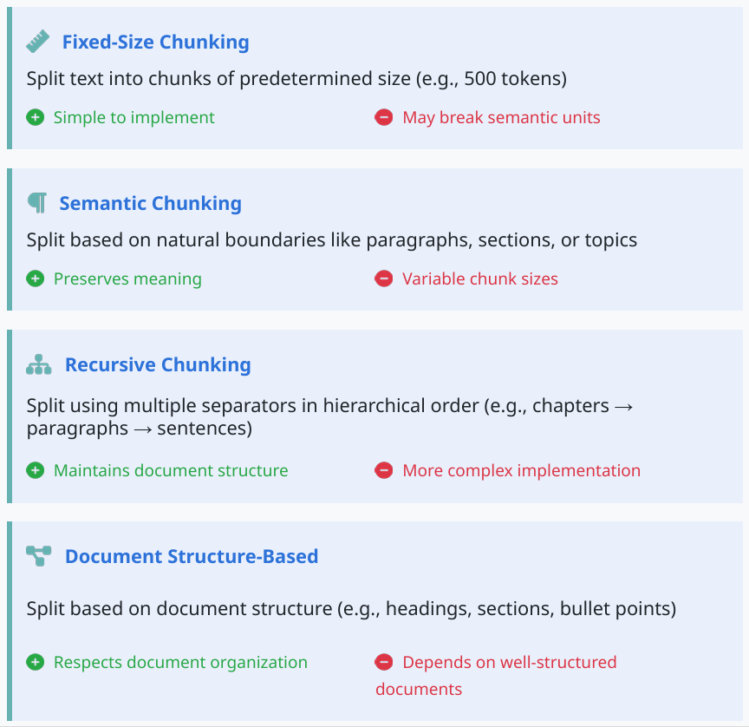
Chunking Strategies
Different approaches to breaking down documents:
12

Slide 14
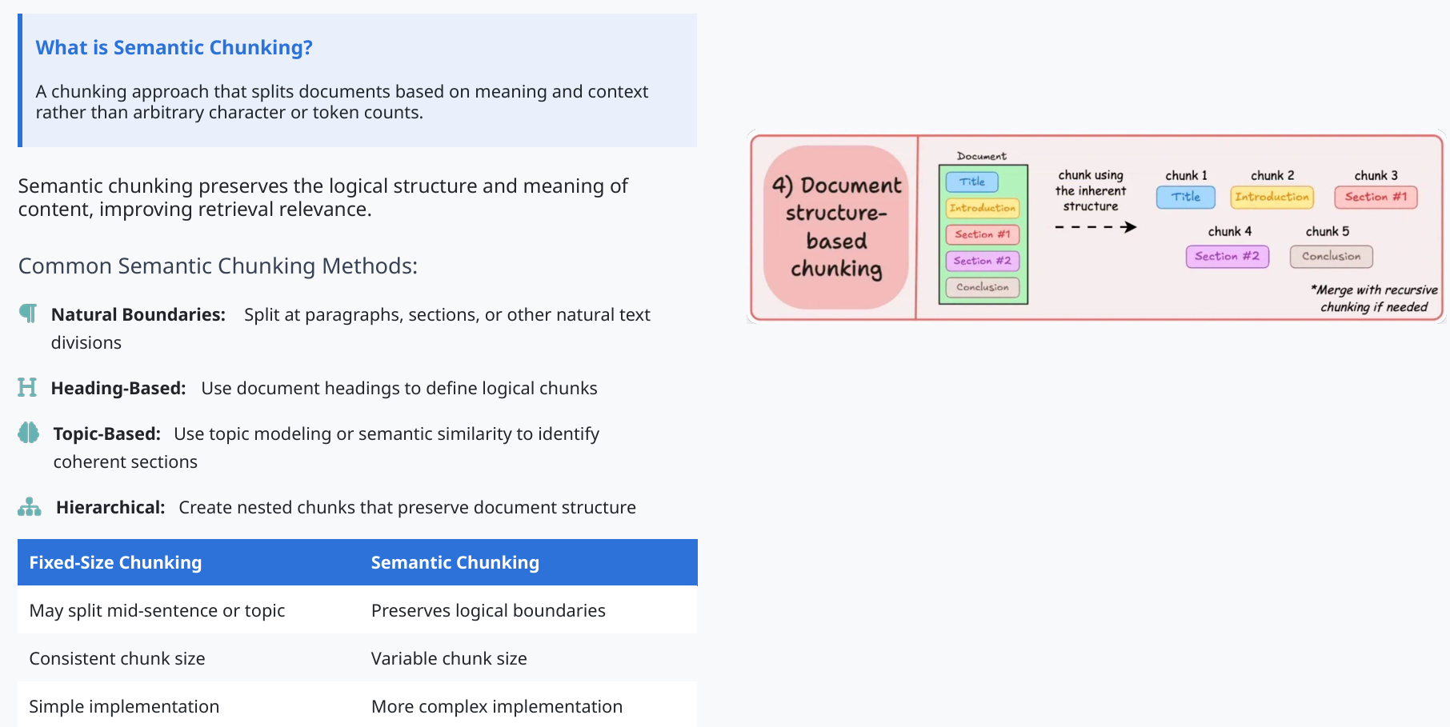
Semantic Chunking
13

Slide 15
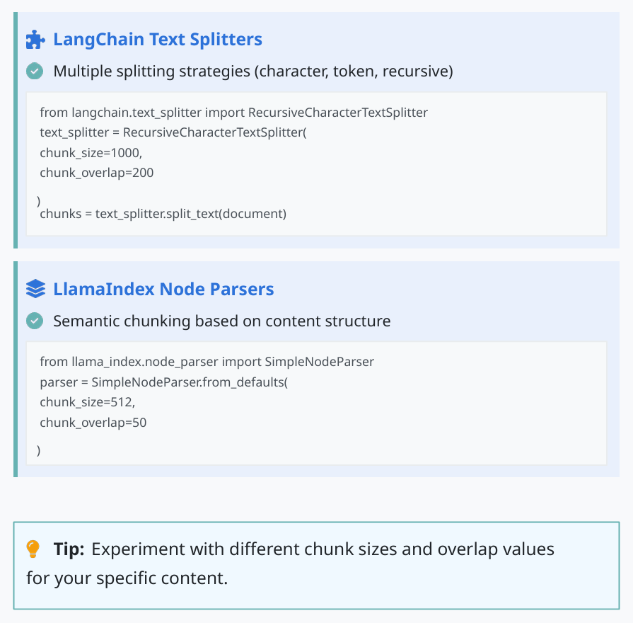
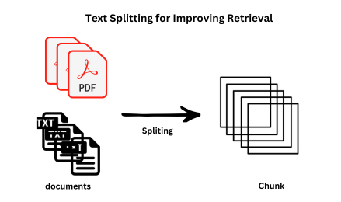
Chunking Tools and Implementation
14

Slide 16
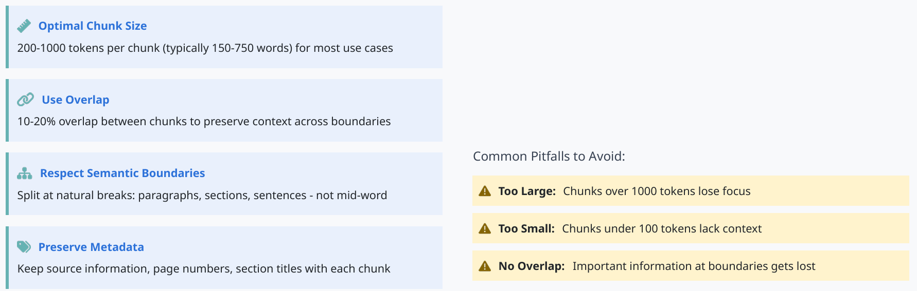
Chunking Best Practices
15

Slide 17
2. Practice

Slide 18
Q / A
21

Slide 19
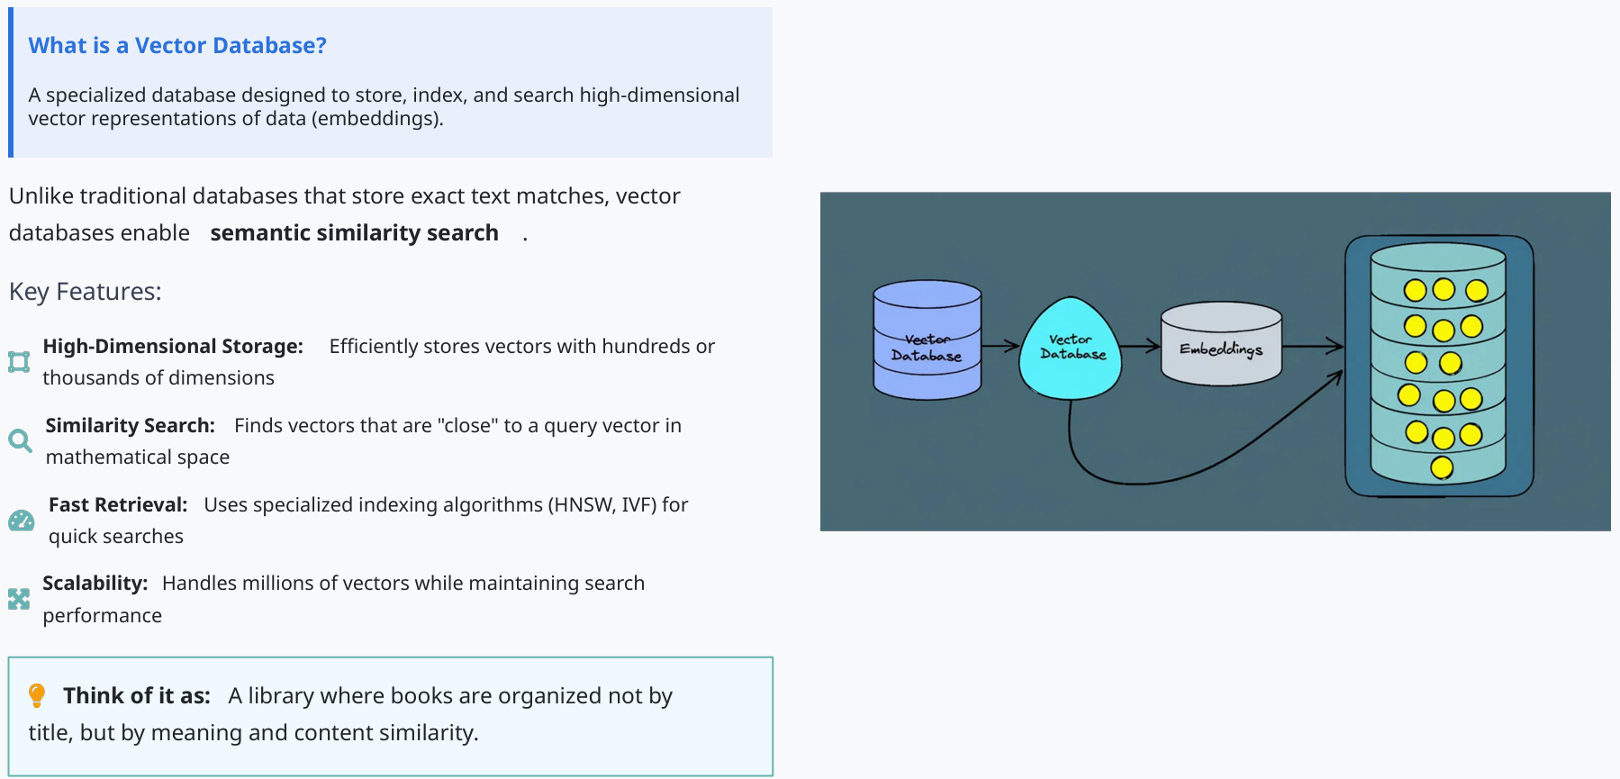
Step 3: Vector Databases - Introduction
16

Slide 20
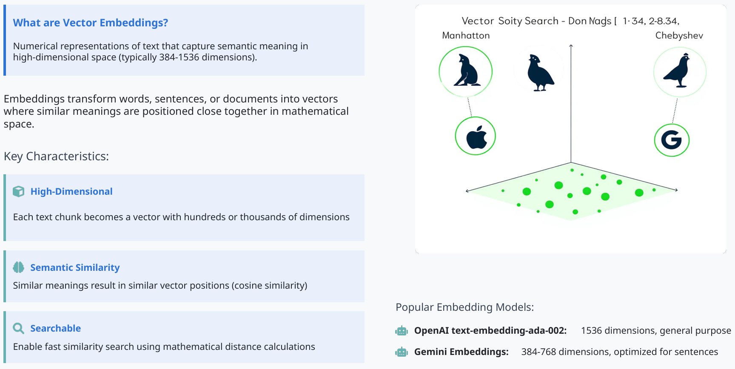
Vector Embeddings
17

Slide 21
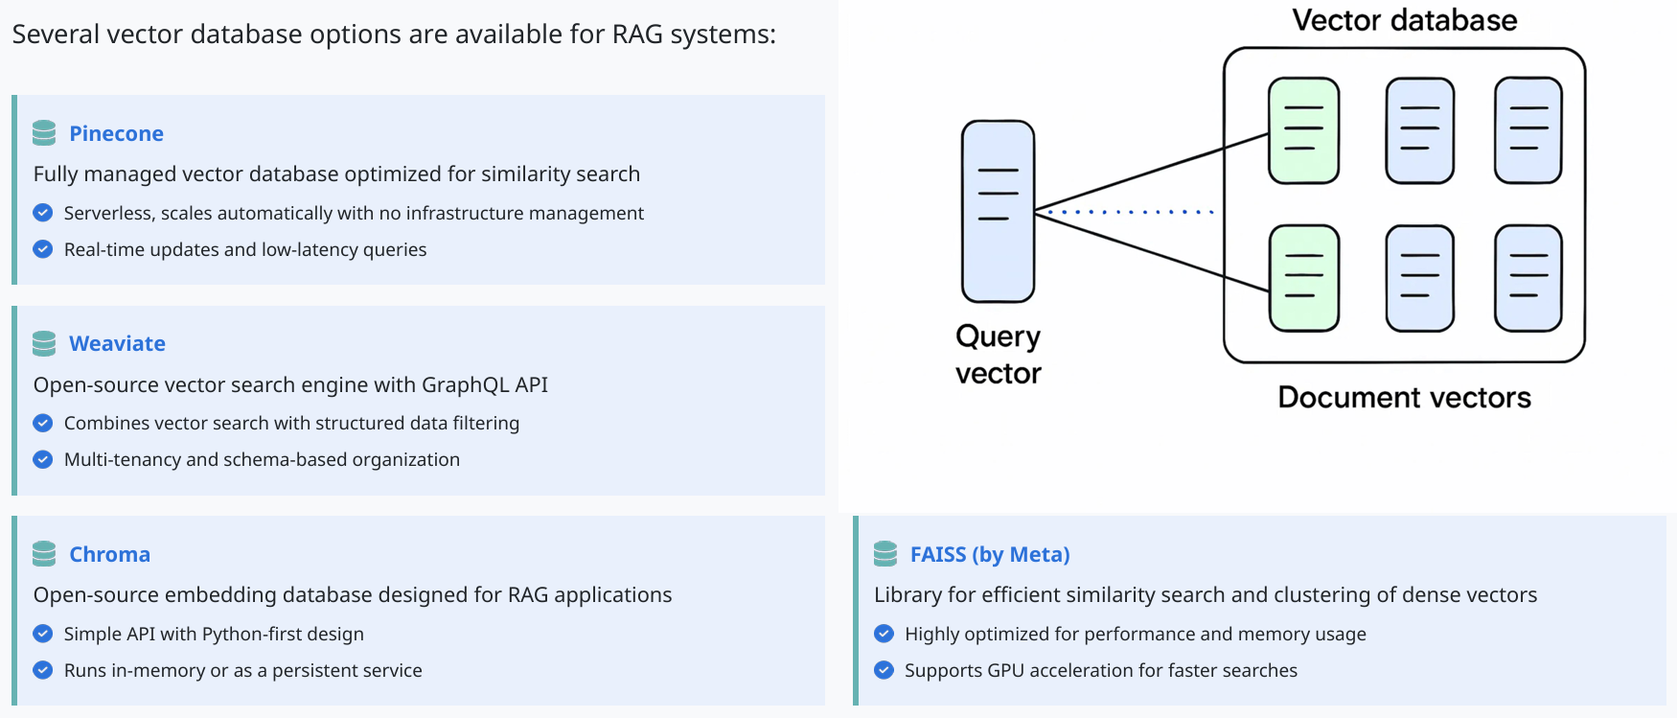
Types of Vector Databases
18

Slide 22
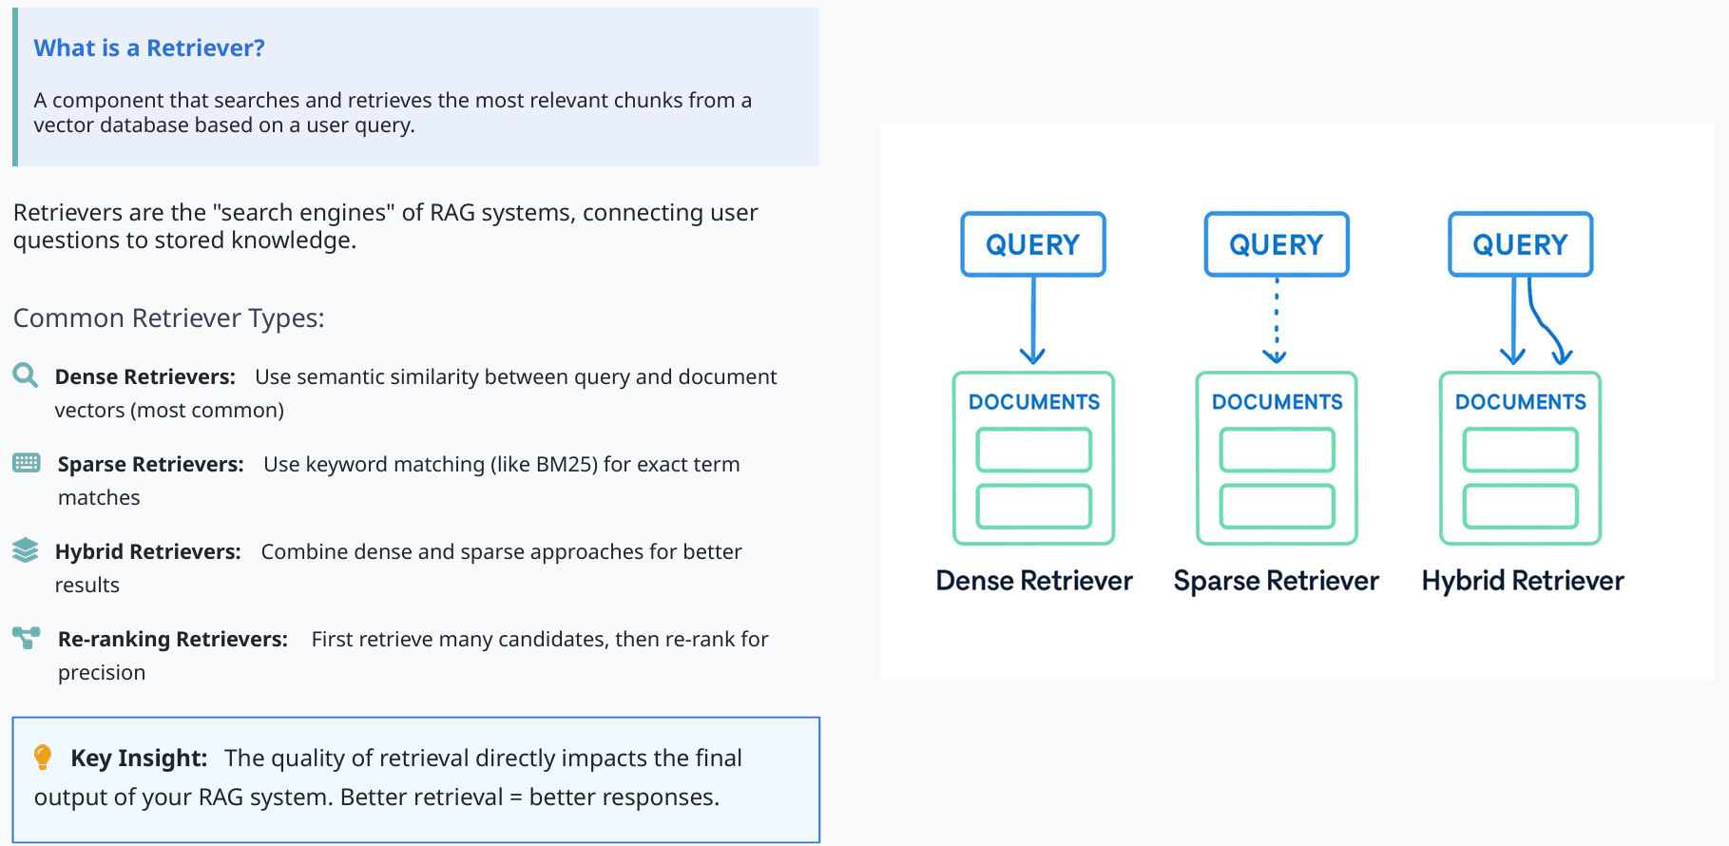
Retrievers and Search Techniques
19

Slide 23
FAISS
Facebook AI Similarity Search

Slide 24
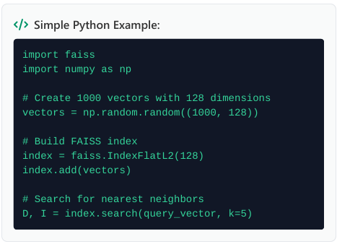
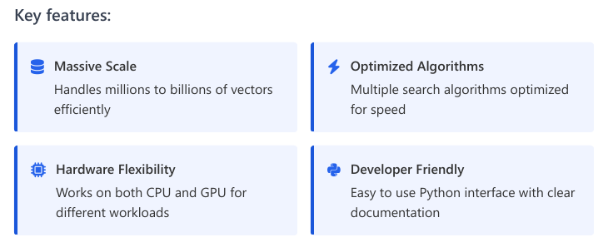
Introduction to FAISS (High Performance Vector Search)
FAISS = Facebook AI Similarity Search
Open-source library by Meta (Facebook)
Designed for efficient similarity search at massive scale

Slide 25
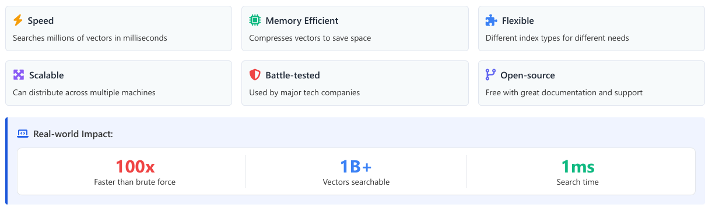
Why FAISS is useful

Slide 26
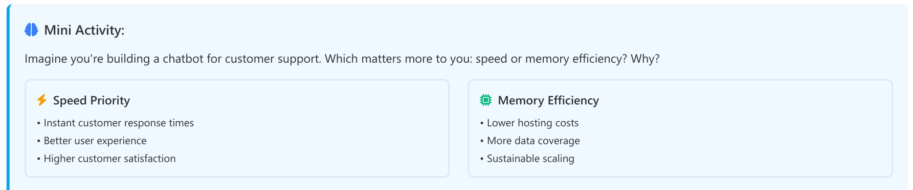

FAISS
Discuss how your choice might change based on different business constraints

Slide 27
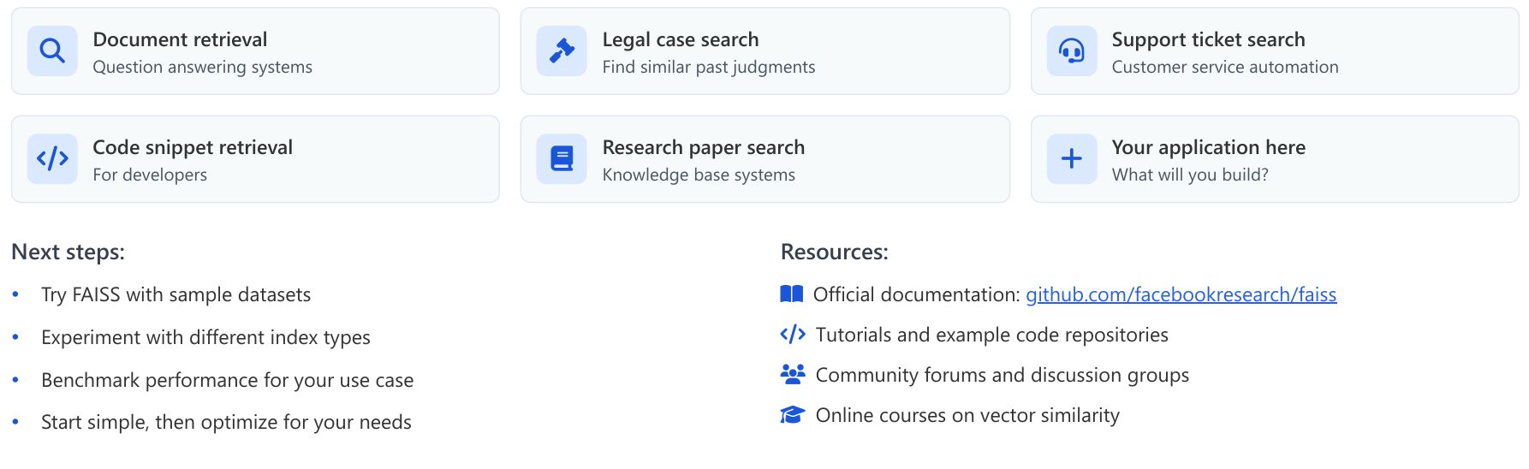
FAISS in Practice - What You Can Build
Real applications using FAISS (RAG-focused):

Slide 28
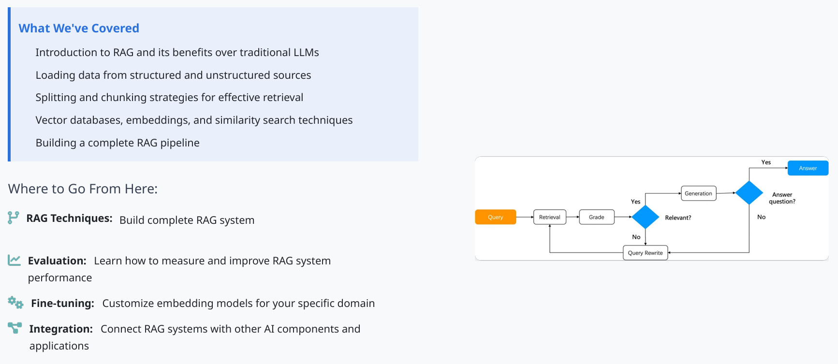
Conclusion and Next Steps
20

Slide 29
Q / A
21

Slide 30
Practice - challenge
Load a small Q&A dataset (e.g., FAQ embeddings) and run a FAISS search
to retrieve the most relevant passages
import faiss
import numpy as np
from sentence_transformers import SentenceTransformer
# 1. Load pre-trained embedding model
model = SentenceTransformer('all-MiniLM-L6-v2')
# 2. Create sample FAQ dataset
faqs = ["How do I reset my password?",
"Where can I download the app?",
"What payment methods do you accept?"]
# 3. Generate embeddings
faq_embeddings = model.encode(faqs)
21

Slide 31
Practice - challenge
# 4. Build FAISS index
dimension = faq_embeddings.shape[1]
index = faiss.IndexFlatL2(dimension)
index.add(np.array(faq_embeddings).astype('float32'))
# 5. Search with a query
query = "I forgot my password"
query_vector = model.encode([query])
distances, indices = index.search(np.array(query_vector).astype('float32'), k=1)
# 6. Display results
print(f"Query: {query}")
print(f"Best match: {faqs[indices[0][0]]}")
21

Slide 32
Thanks
22

